Slide 1
Android Application for On-Street Parking
Group members:
Namrata Prajapati-36
Krina Mandavia-20
Bhakti Palkar-23
Guided By
Prof. Reena Somani
Prof. Pranoti Nage

Slide 2
Index
Abstract of Project
Introduction to On-Street Parking
Aims and Objectives
Literature Survey
Problem Statement
Scope
Details of hardware & software
Implementation
Results and discussion
Conclusion
Future scope
Publications
References

Slide 3
Abstract
Parking search is a challenging task in most urban areas. The traffic resulting from drivers cruising for parking has a great effect on the environment , increasing energy consumption and emission of CO2 .As our country is progressing from developing to developed country status, traffic in city is one of the hectic problems all cities are facing. There is double digit growth of car owning customers e.g. in Mumbai there are 25 lakh cars .At any given point of time especially during peak hours there will be need for any car to find a parking space along road or in the enclosed premises. Over that finding an exact location of parking slot is also important to avoid back traffic and wasted rounds to search parking place.

Slide 4
Introduction to street parking
In metropolitan cities like Mumbai where the population is at its peak and the roads are all messed with vehicle’s and long traffics.
In such over increasing demand for vehicle’s it becomes a difficult job to find a parking spot for our wheel’s. Due to this the people are forced to haphazardly park their vehicle wherever they find space, which result in traffic offence like illegal, haphazard double or angular parking.
To overcome such parking crisis in Mumbai the user can use a mobile application to check availability of parking slots, which are in the vicinity of their destination.
Using that application driver can also book a parking slot. The application will provide a route for the driver from his current location to the parking slot with an estimated time considering traffic in the route.
If the driver does not reach the parking spot on time than the slot booked will stand canceled.
Thus, a simple application will help the driver to find a valid parking spot near their destination.

Slide 5
Aims and Objectives:
To help user find roadside parking space by showing parking slots on the application.
To show exact range of no parking.
Generating revenue for municipality.
To avoid back traffic and reduce searching time.
Balancing parking against other competing uses of space, such as pedestrian space, transit priority lanes or bicycle paths.

Slide 6
Literature Survey
IEEE Papers | Content Studied | Year of Publish
A Recommendation model of Smart Parking | An android application to help user find parking slot in urban city on his preference.[1] | 2017
Application development for reservation based parking slot allotment and management system using android | The searching and allotment of parking slot based on the status of available slots, the microcontroller makes the path for the vehicle to the appropriate free slot, makes parking of the vehicle easier.[3] | 2017
Smart Urban Parking Detection System | An android application using Google Maps API ,Sensors and a local server for management of parking system [2] | 2016

Slide 7
Problem Definition
Our main purpose behind pursuing this idea of developing an application where users could book a parking spot just like booking movie tickets is to save people’s time and fuel and also relieve the congestion on Mumbai roads. With the help of this application users can enter their required location and based on that the application shows various parking lots nearby along with the vacancy status. The user then selects the desired parking lot, slot and the exact parking spot. Accordingly, the Google maps API provides a route to that parking lot showing the estimated time of arrival (eta). The system generates a time limit within which the user should reach the location otherwise the booking stands cancelled. The same will be notified to the customer. The time limit is generated based on the time user will take to reach the location (which also takes into account the traffic to reach the location) plus some extra time for variable reasons. Our system deals in real time and will perform real time monitoring of parking for four wheelers.

Slide 8
Scope
Functional Requirements
Parking slot location
Real-Time parking availability details
Book parking slot online
The booking period will be decided based on travel time from user’s destination based on current traffic analysis

Slide 9
Details of Software
Software Technologies
Android SDK
Android Studio
Visual Studio
MySQL

Slide 10
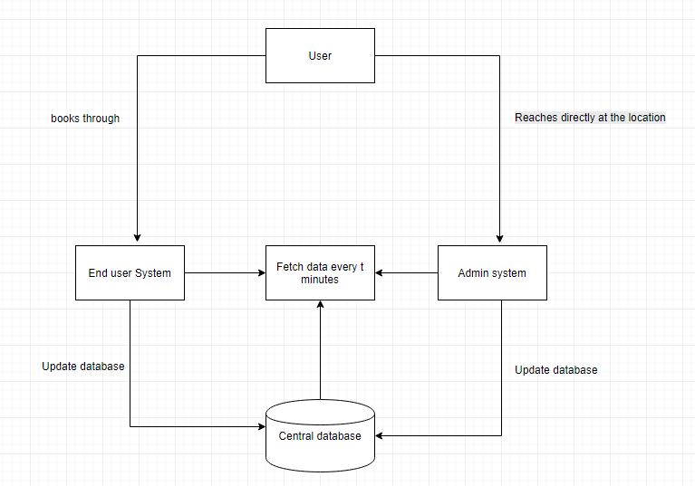
Design Implementation And Analysis
Block Diagram:

Slide 11
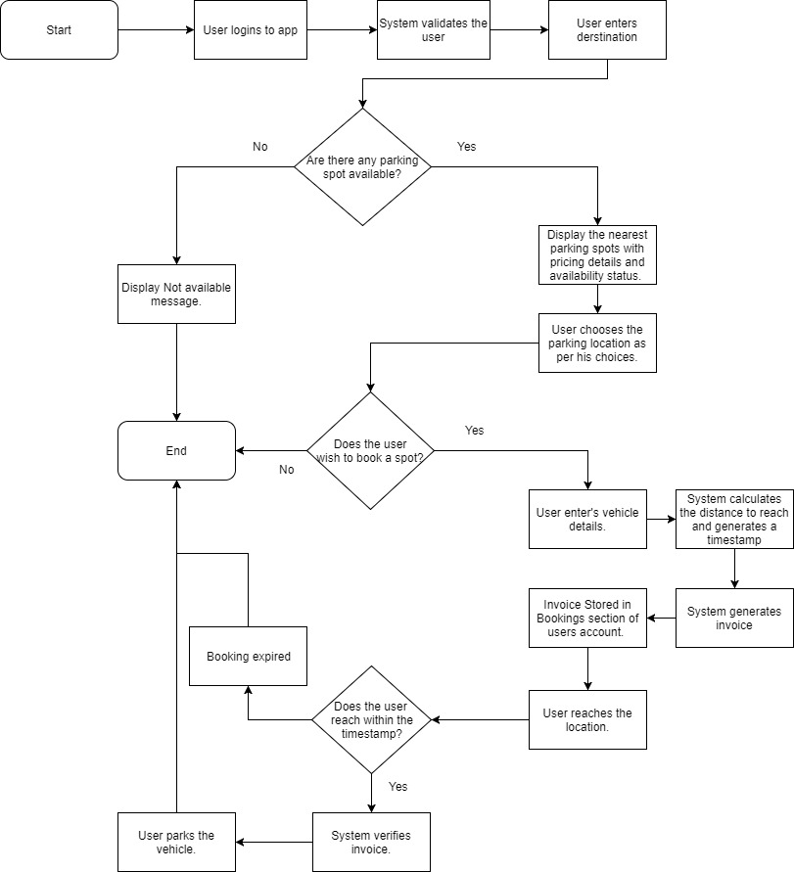
Flow Chart:-

Slide 12
Results And Discussion

Slide 13
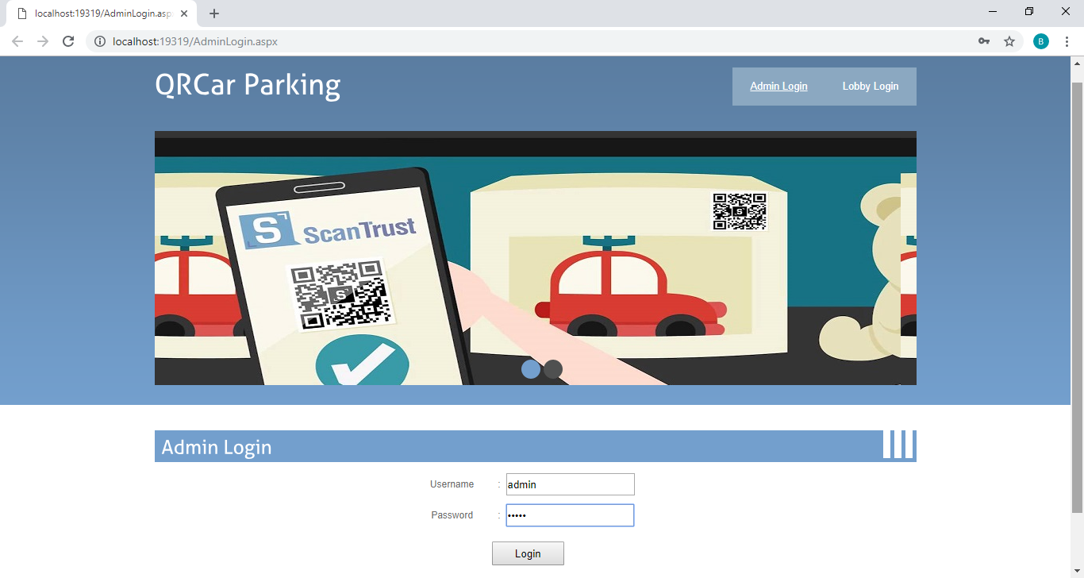

Slide 14
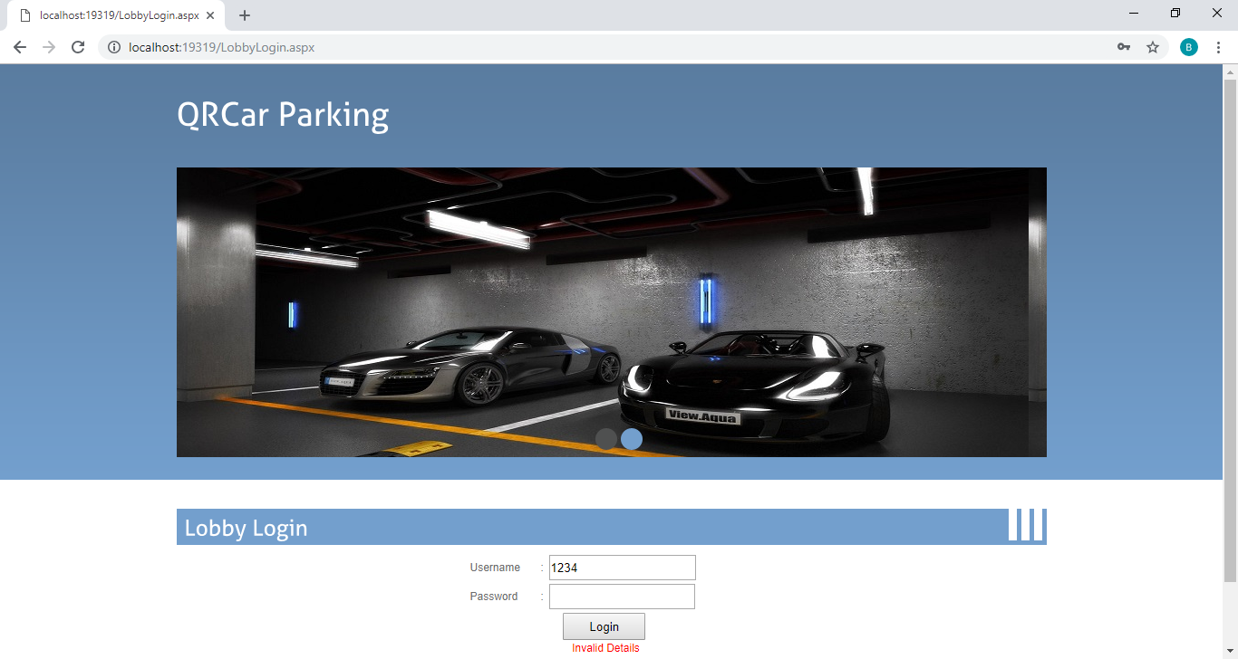

Slide 15
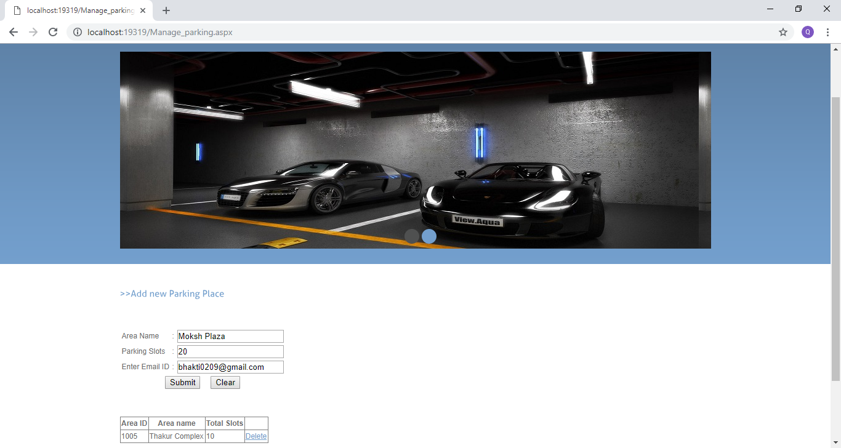

Slide 16
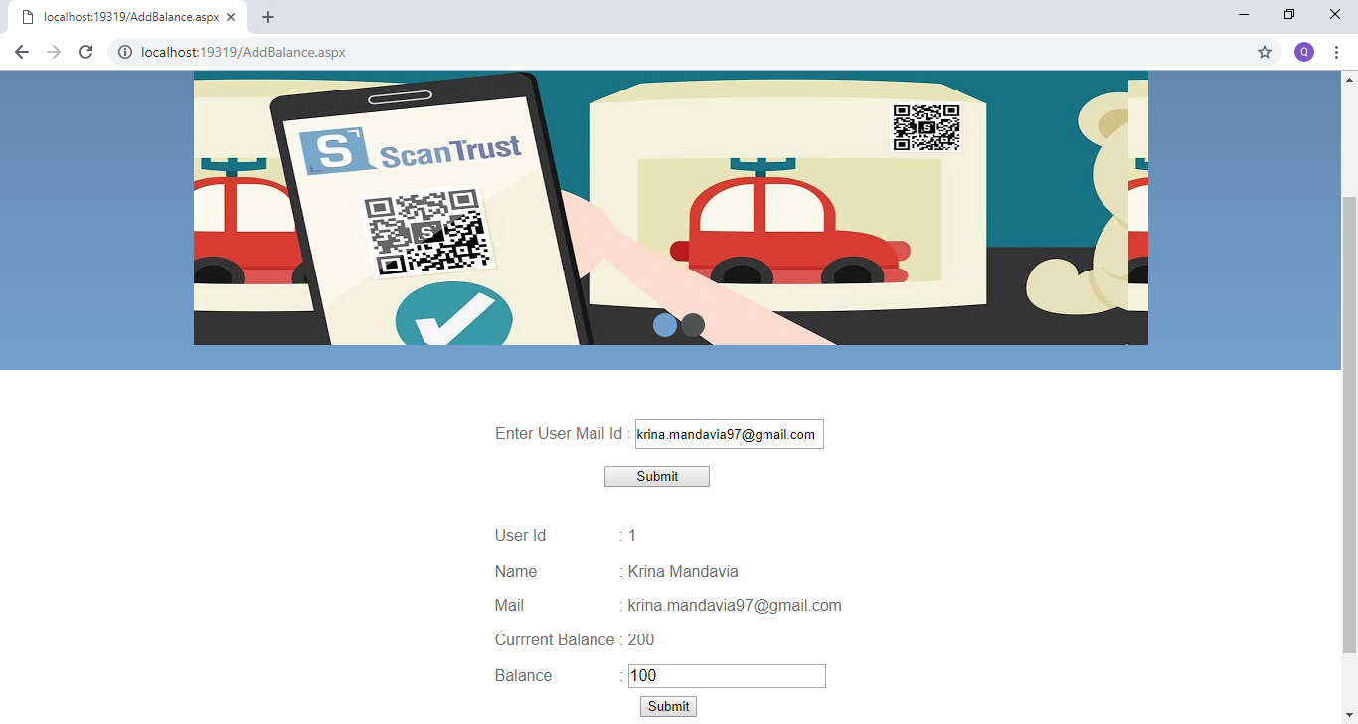

Slide 17
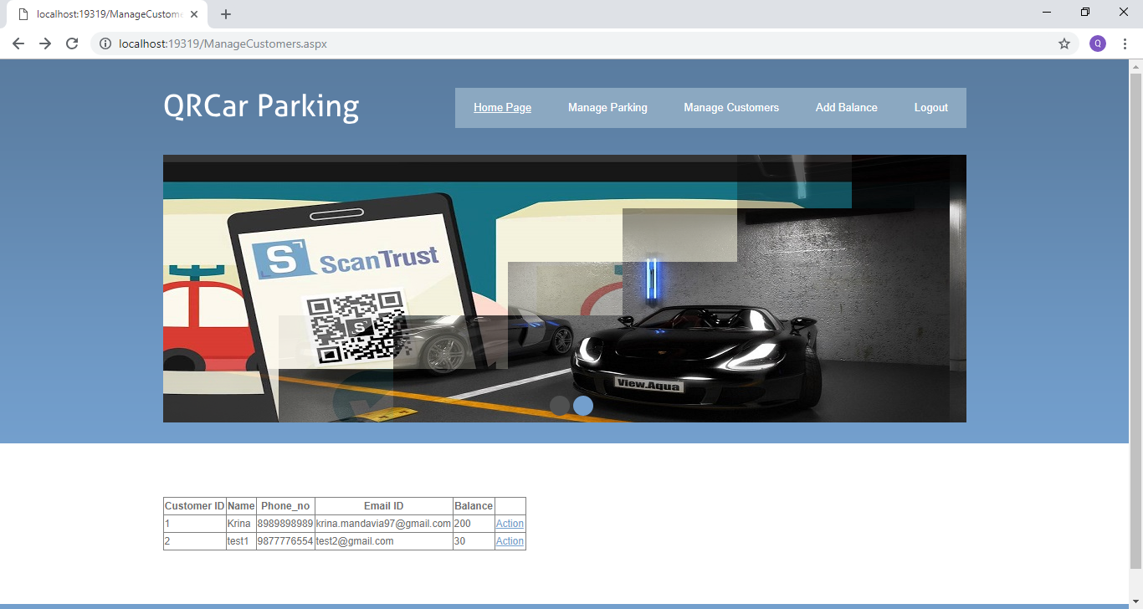

Slide 18
Conclusion
The main objective of this project is to allow the user to view the status of any parking lots and based on the users need and requirements she/he could book a parking spot. Generally, the customers tend to go to the parking lots and then see if there is vacancy then they park their car or else they find some other location. So instead if the users already knew that the parking lot where the user is going to visit has vacancy or not and if not than from the application user could find another parking spot. So, our goal is to aid the users in finding and booking a parking spot saving their time and fuel and also relieving traffic on Mumbai roads.

Slide 19
Future Scope
Furthermore, using this system we could study the congestion caused at prime areas of Mumbai and provide more parking lot services thereby reducing the traffic problems.
We could include the pass system for the customers that very often use the parking spaces by studying the data collected through the application and the website. And this data collected could be used for security purposes.

Slide 20
Publications
Sr. No. | Paper Title | Category | Status | Journal
1. | Android Application For On-Street Parking | Research Paper | Submitted for review | International Conference on Innovative and Advanced Technologies in Engineering

Slide 21
References
Chin-Ling Chen, Wei-Cheng Chiu,” A Recommendation Model of Smart Parking,” in IEEE 13th International Conference on Natural Computation, Fuzzy Systems and Knowledge Discovery (ICNC-FSKD 2017),2017.
Nastran Reza Nazra Zadeh, “Smart Urban Parking Detection System,” in 6th IEEE International Conference on Control System, Computing and Engineering,25-27 November 2016
Prof. R. S. Sandhya Devi, Dr. V.R. Vijay Kumar, S. Sridevi,” Application Development for Reservation Based Parking Slot Allotment and Management System Using Android,” in IEEE International Conference on Innovations in Information, Embedded and Communication Systems (ICIIECS),2017.

Slide 22
Thank You!!!

